Slide 1
Capstone Design (Vino)
명순조, 명순철, 배동규, 윤승환

Slide 2
Content
- CheckList
- Roadmap
- Details
- Software & Hardware
- Q & A
- Reference literature

Slide 3
System Design Check List |  |  | 명순철 | 명순조 | 배동규 | 윤승환 | Procedure/Message
System Architecture |  |  | o | o | o | o
ER Model |  |  | o | o | o | o
Create presentation |  |  |  | o
Announcement |  |  | o |  | o | o
Procedure | Android | Camera Function |  |  | o
 |  | Connect Database |  |  | o
 |  | User Management
 |  | Random Recommend
 |  | Setting
 | AI | Collect Dataset |  | o
 |  | Data Normalization
 |  | Connect Database
 |  | Inception v3 Neural Networks |  | o
 |  | Validation Test |  | o

Slide 4
구분
Android
Database (Firebase)
AI
Common
UI Development
Camera Function
Move to Camera Image Database
Receive Results
Add Information if new data
Create Reviews
Output of Matched Information
Save Reviews to Database
Random Reviews
Database Structure Design
Develop a communication method using realtime databases.
Wine Unique Number Setting
Create Image Storage
Collect
Data set
Data normalization
With camera scanner
Create Inception v3
Loading database stored Images
Update new data to mo
Change format
dataset to .txt
Data Learning
Program with learned model
Move to the Results database
Idea Conference
Preparation of Final Report

Slide 5
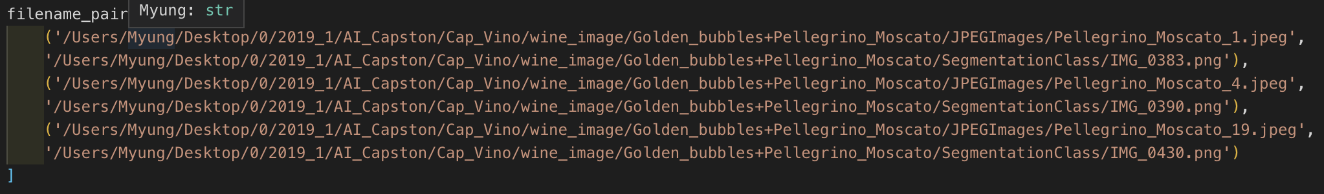
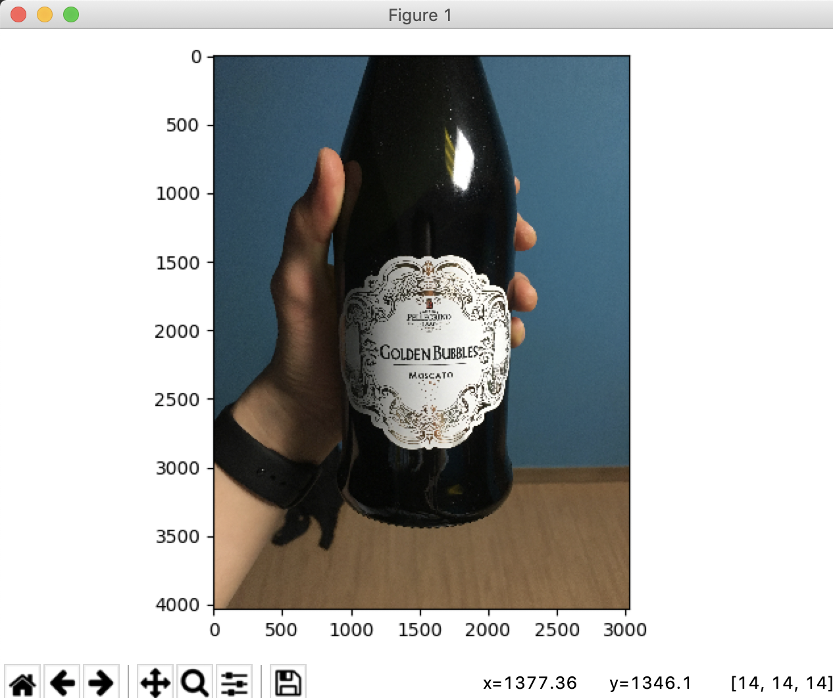
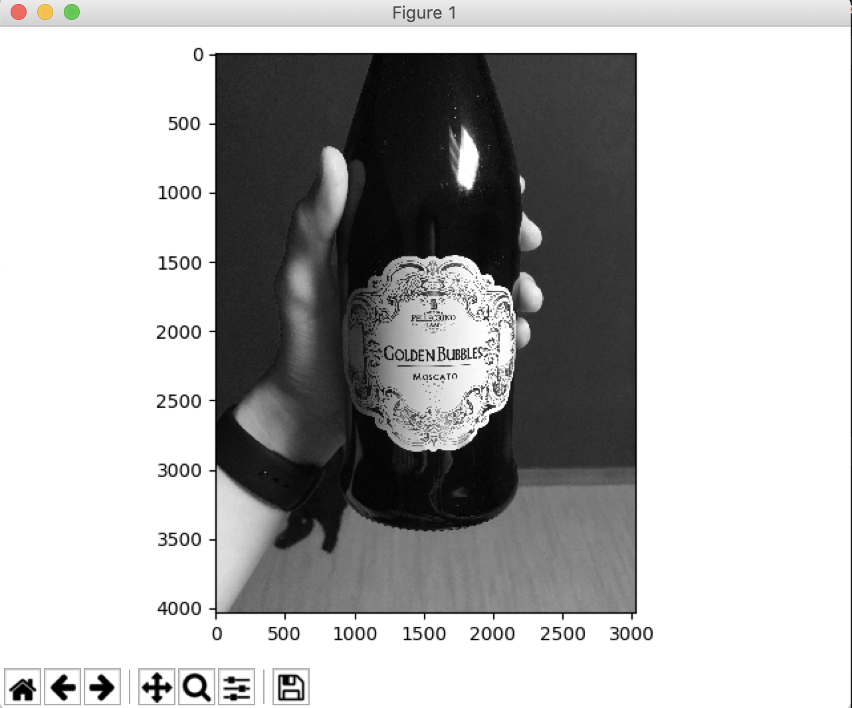

dETAILS

Slide 6
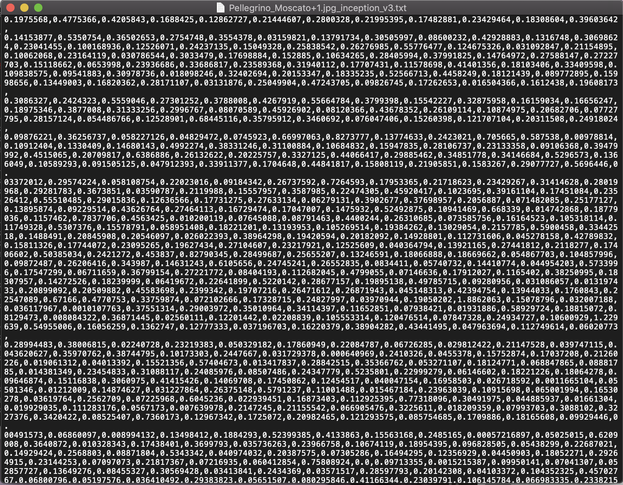
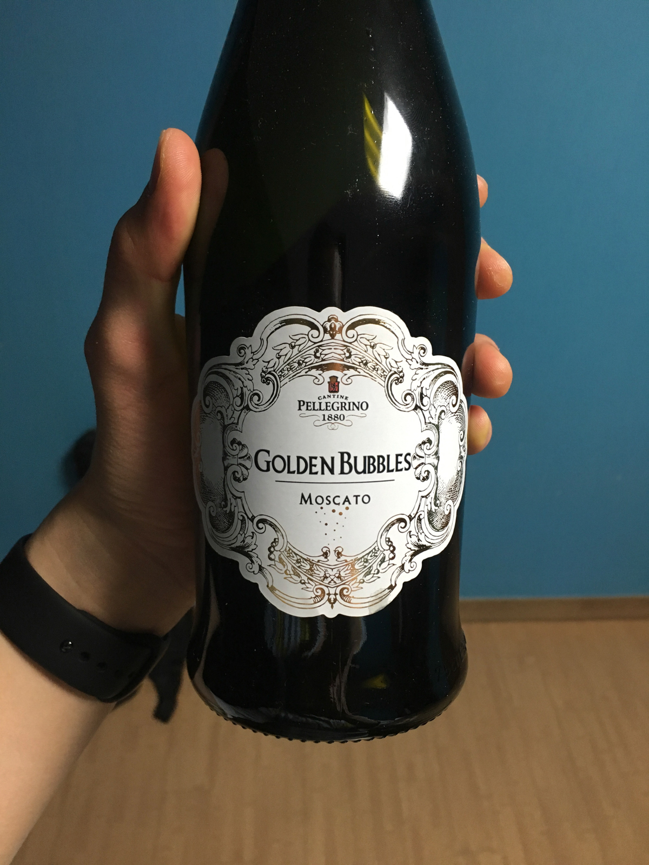
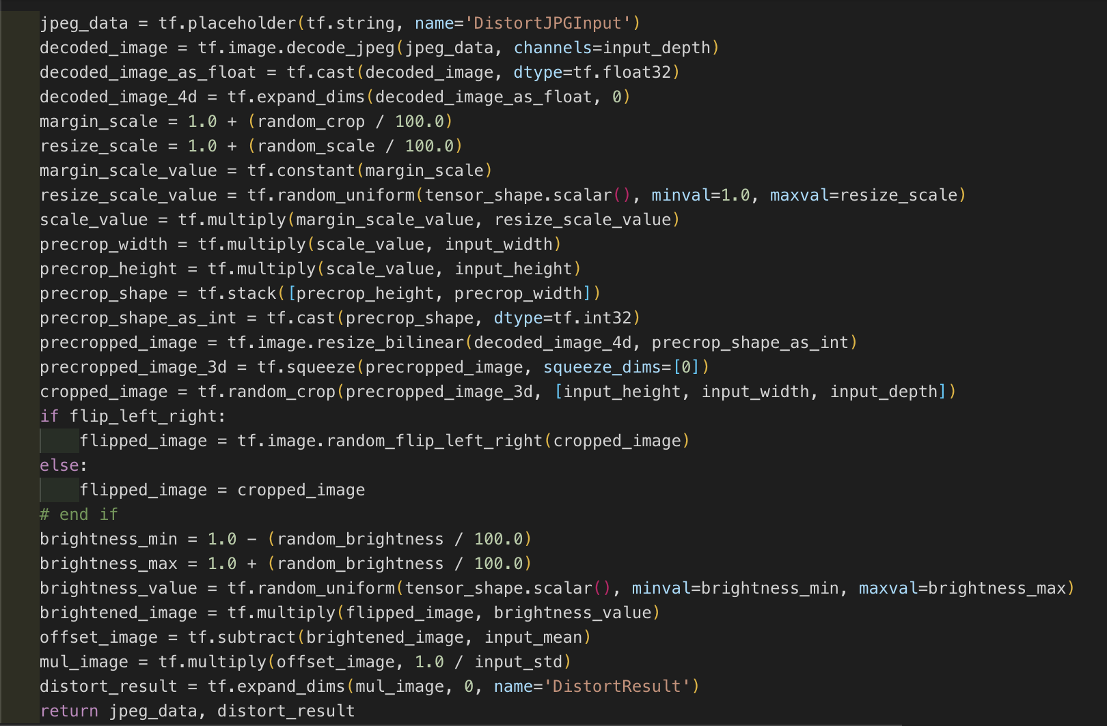
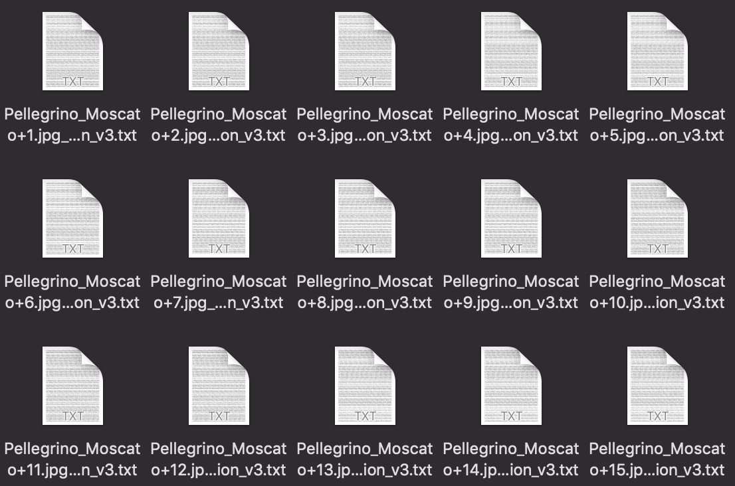
dETAILS
150
X

Slide 7
dETAILS

Slide 8
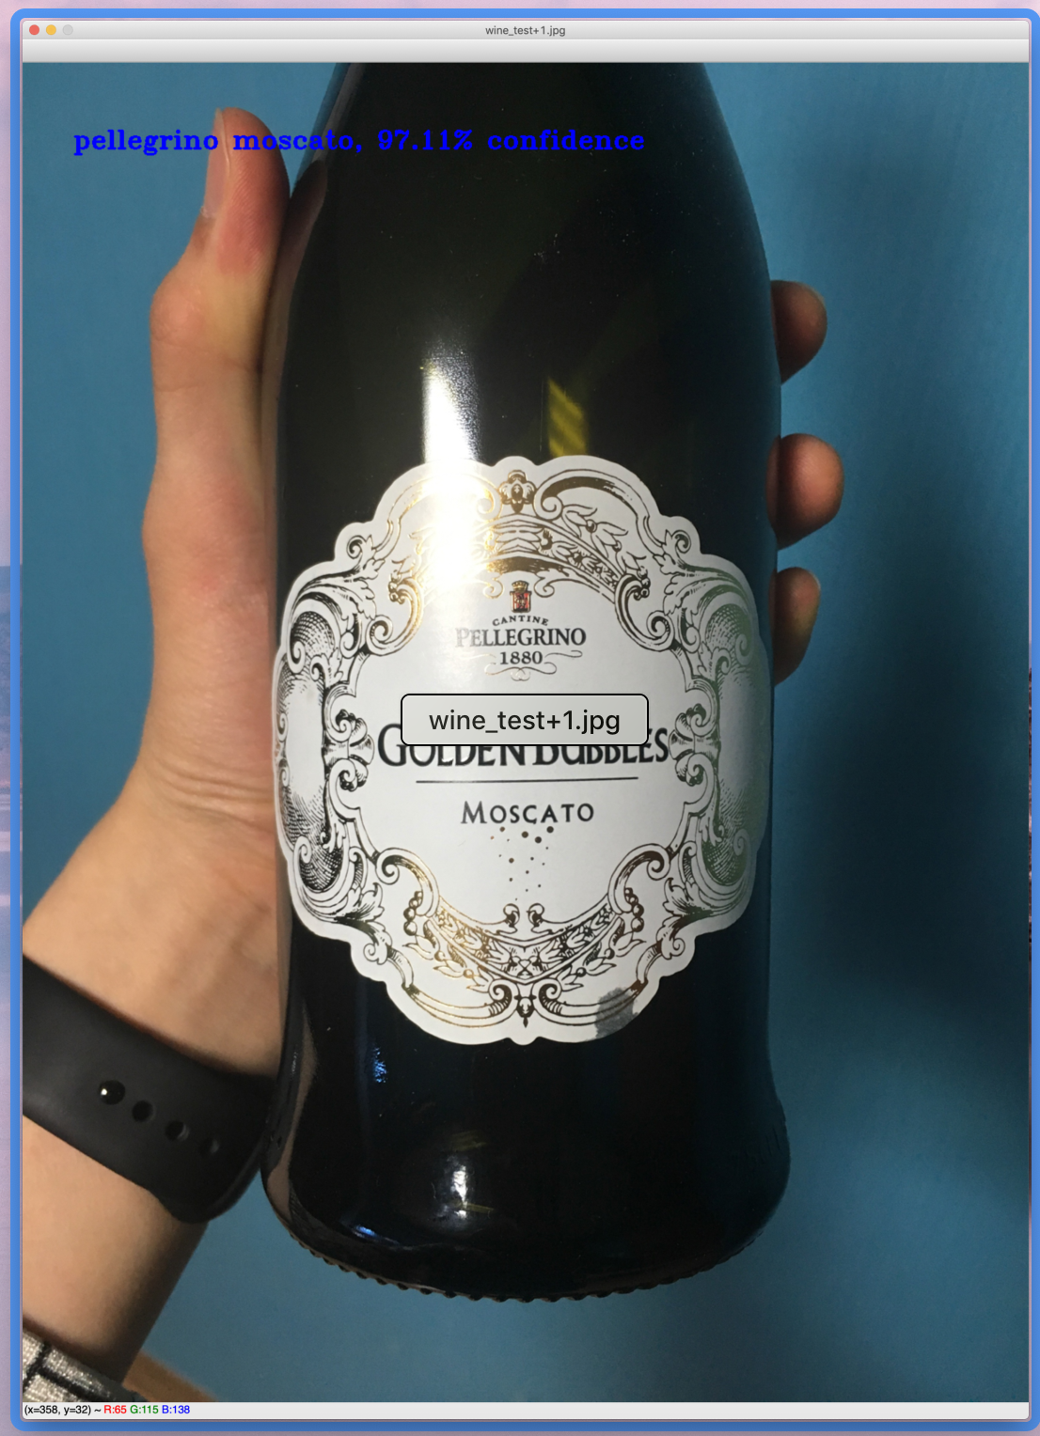
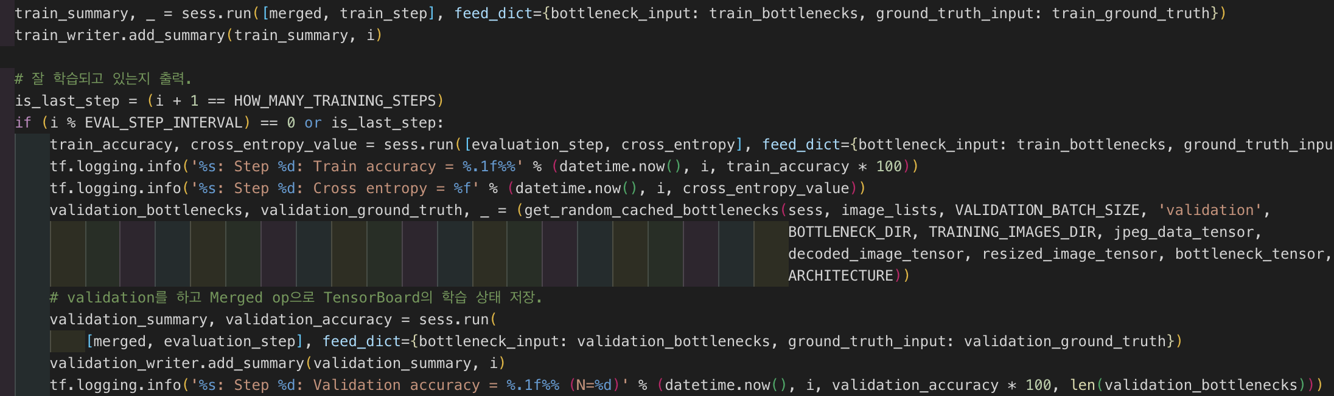
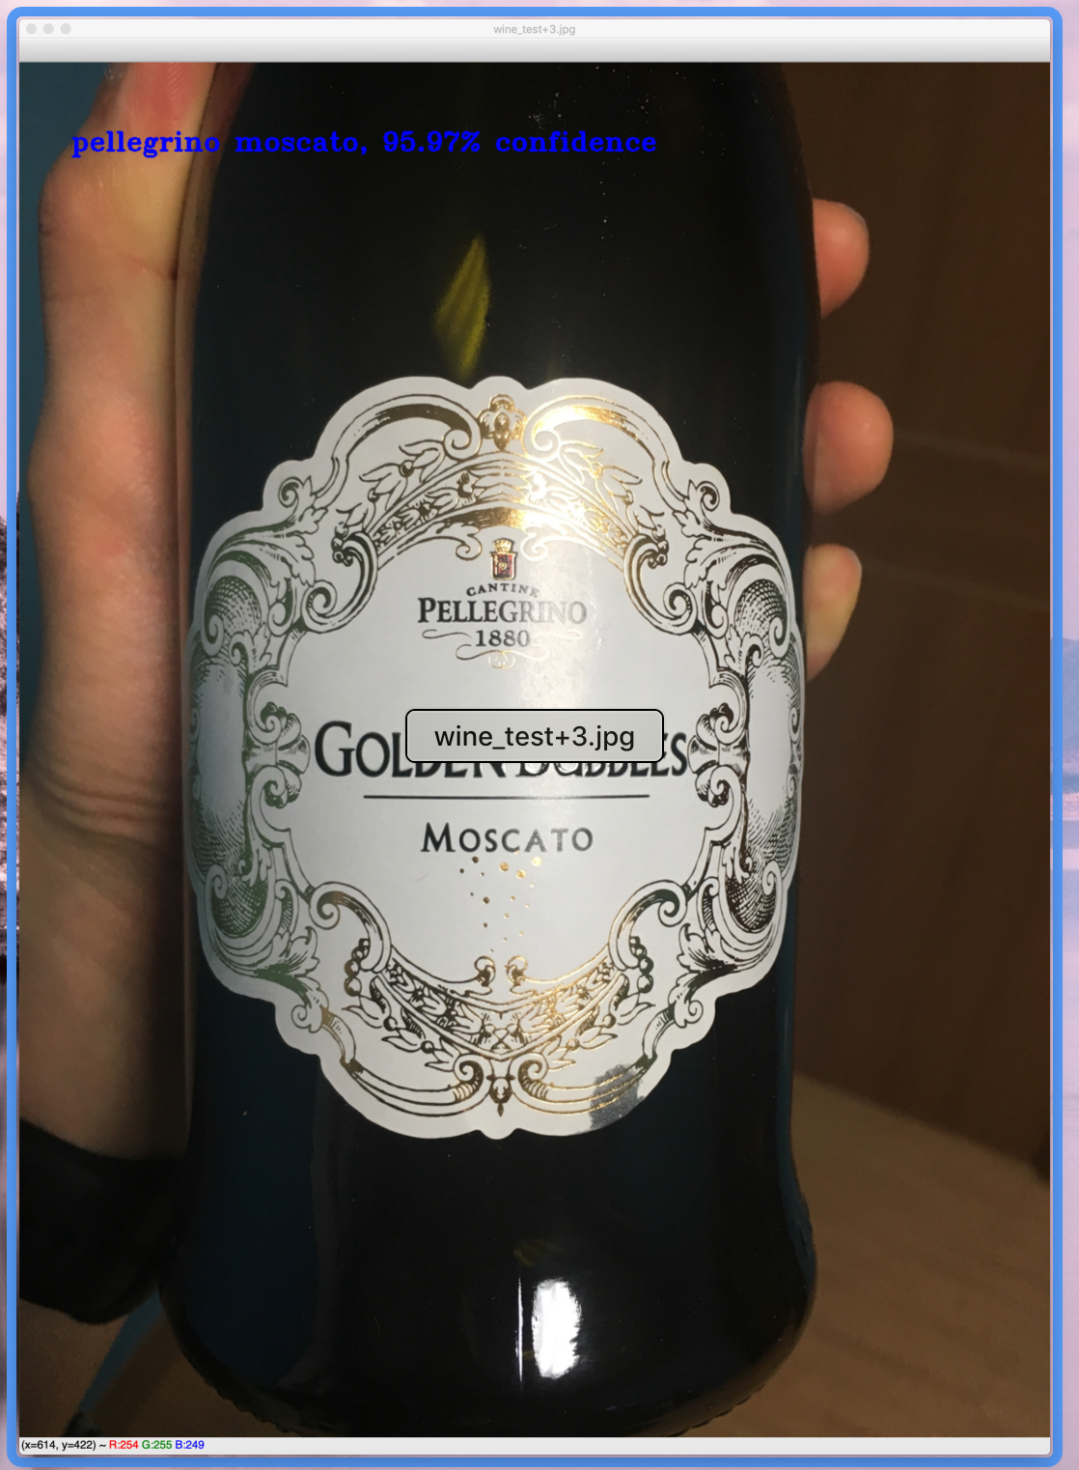
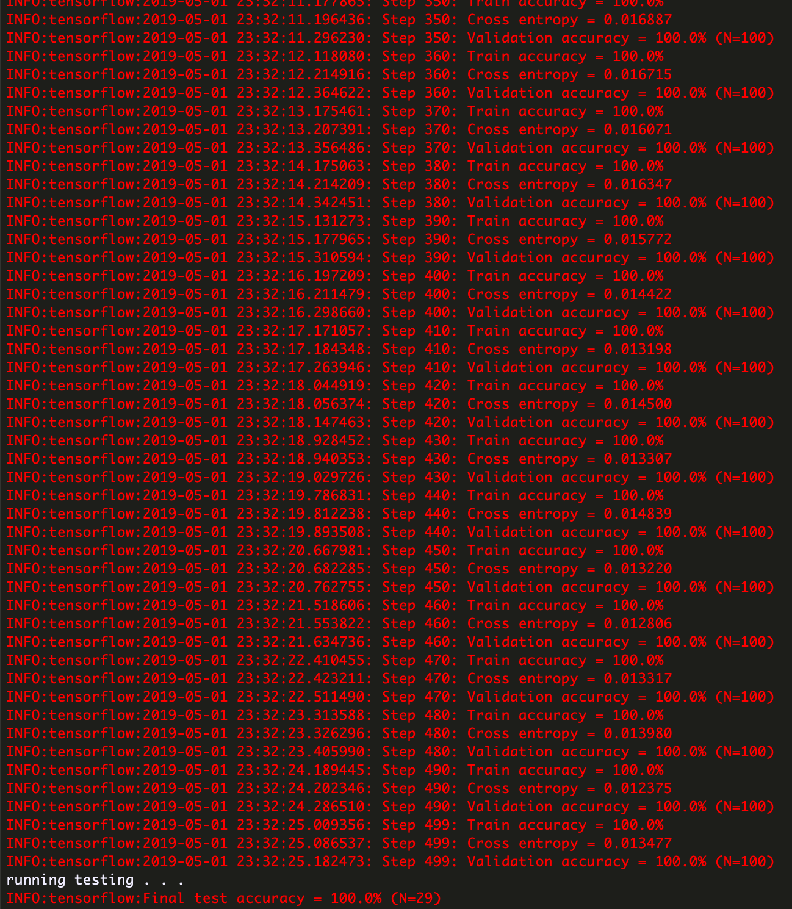
dETAILS

Slide 9
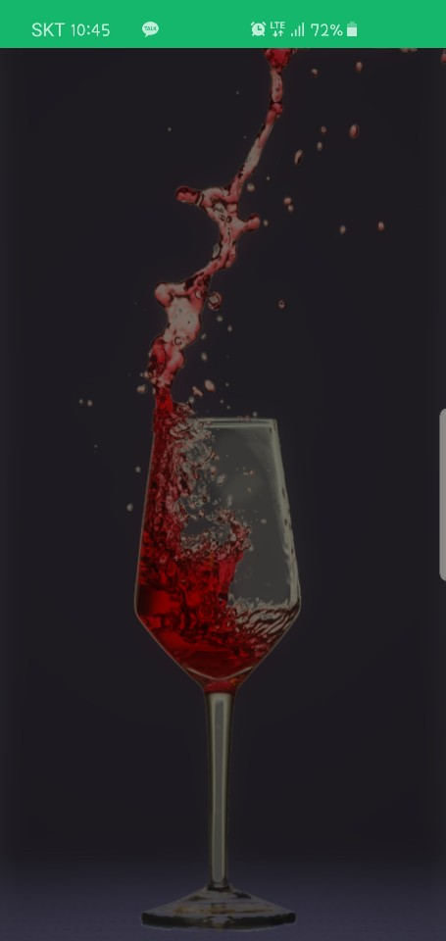
dETAILS
dETAILS

Slide 10
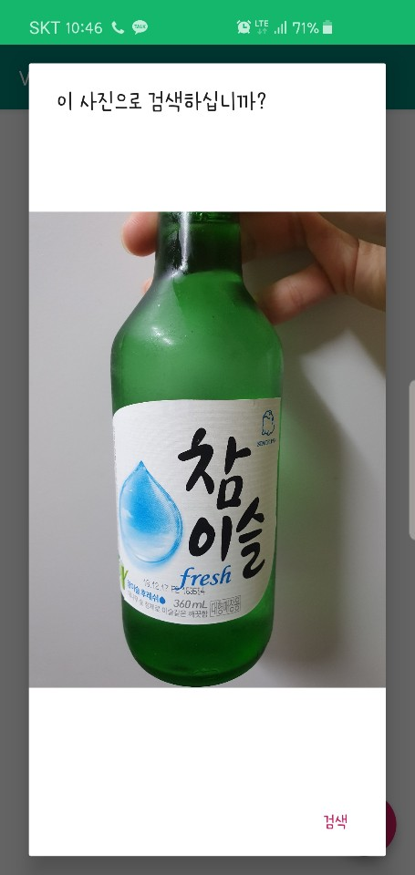
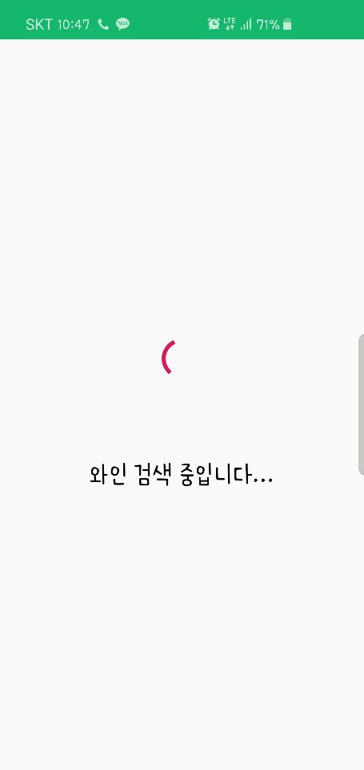
dETAILS

Slide 11
사용 중인 소프트웨어 & 하드웨어
명순철 | 명순조 | 배동규 | 윤승환
Windows 10 64bit | macOs Mojave | Windows 10 64bit | Windows 10 64bit
Intel Core i7 | Intel Core i5 | AMD Ryzen 5 | Intel Core i5
Ram 16GB | Ram 8GB | Ram 16GB | Ram 8GB
NVIDIA GeForce GTX 1050 | Intel Iris Plus Graphics 650 | NVIDIA GeForce GTX 1060 3GB | NVIDIA Geforce GTX 765M
Android Studio FireBase | Visual Studio Code Python | Android Studio | IDLE Python

Slide 12
Q & A

Slide 13
참고문헌
Timnit Gebru, Oren Hazi, Vickey Yeh Department of Electrical Engineering, Stanford University, Stanford, CA 94305
https://digitalbourgeois.tistory.com/50 | TFRecord 파일 생성 방법(텐서플로우 데이타 포맷)
https://gusrb.tistory.com/12 | TFrecord 원하는 이미지 학습을 위한 데이터셋 만들기
https://github.com/savannahar68/CamScanner-Python/blob/master/scannerApp.py | CamScanner-Python
http://warmspringwinds.github.io/tensorflow/tf-slim/2016/12/21/tfrecords-guide/ | Tensorflow and TF-Slim

Slide 14
참고문헌
https://blog.naver.com/cenodim/220945521396 | CIFAR-10 딥러닝으로 학습
http://euhyeji.blogspot.com/2017/05/tf-11-slim-31-caltech-tfrecord.html | (TF 1.1 & SLIM) 3 내 이미지로 학습하기( CALTECH )
https://datascienceschool.net/view-notebook/9af8d8e93c084bc49f0ac2bb8a20e2a4/ | 이미지 처리 기초

